Slide 1
Modular context-based stamp

Slide 2
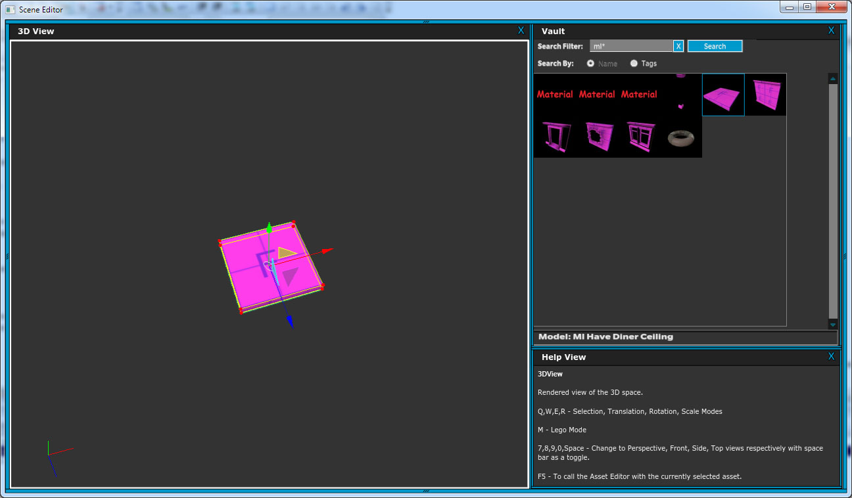
Drag floor piece into scene

Slide 3
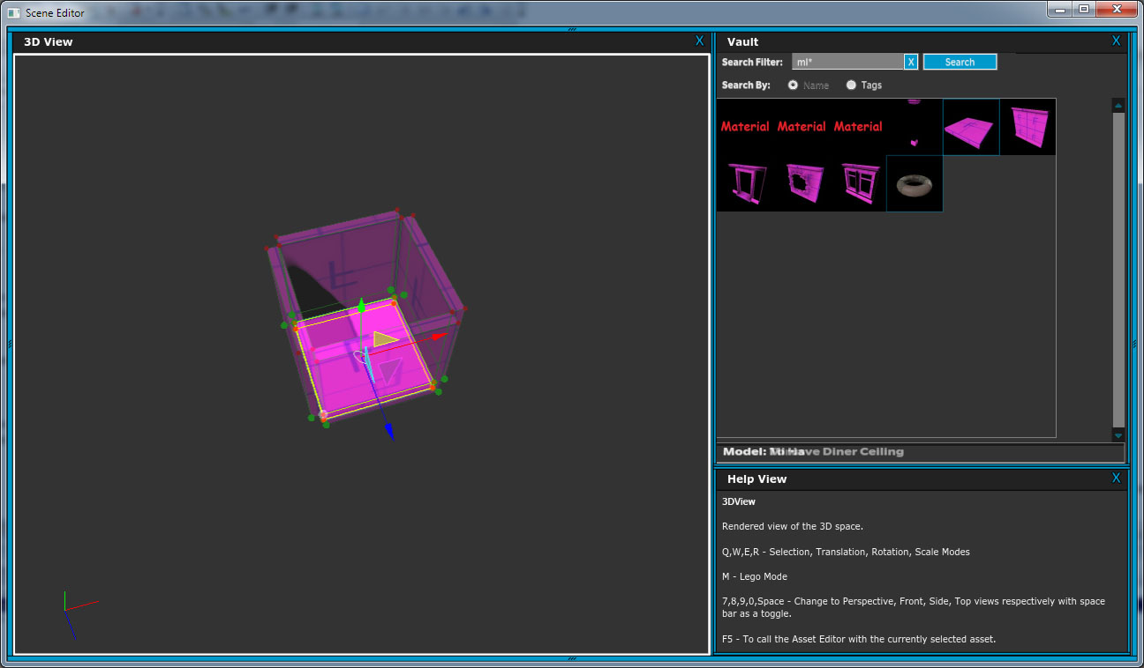
Hit hotkey to “modular stamp mode”
Initially see one set of connections this floor piece was setup with.
(floor -> wall)

Slide 4
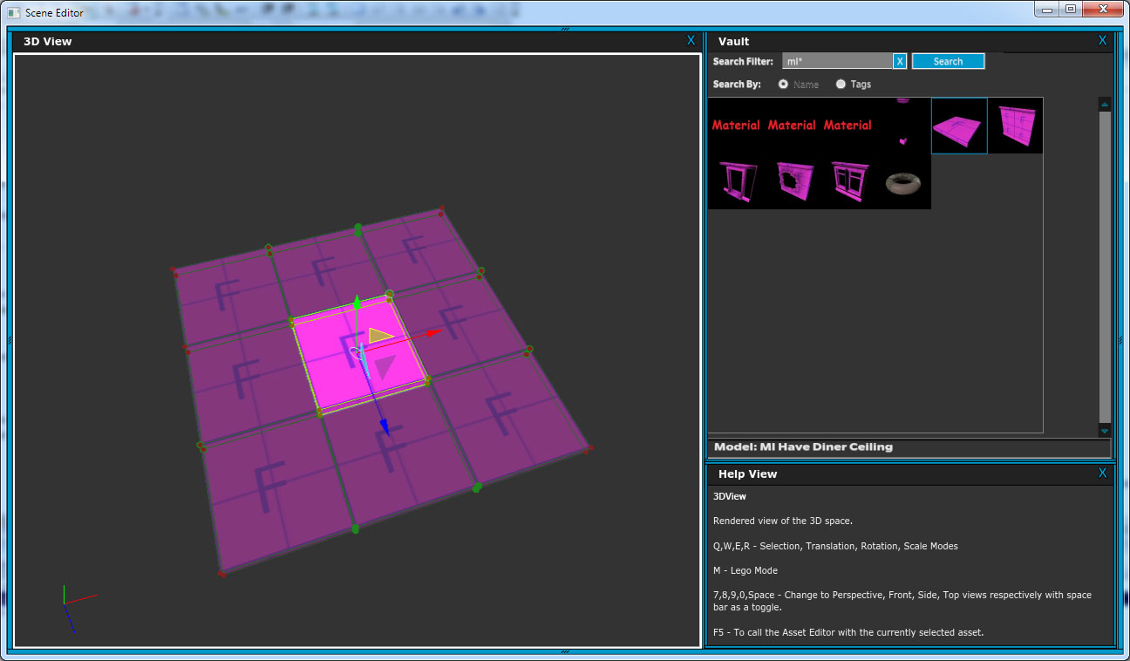
Hit key to tab to the second set of connections the floor piece was setup with
(floor -> floor)

Slide 5
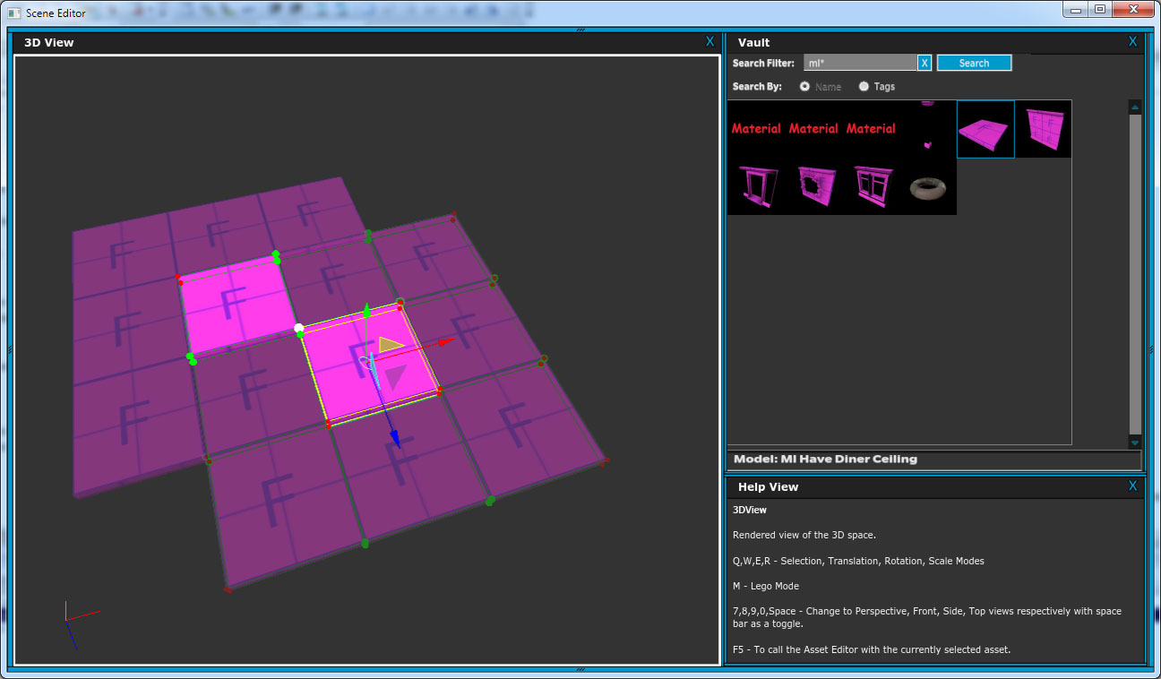
Click on ghosted piece to “stamp”
i.e. make that instance.
See the ghosted snaps of this new piece in addition to the original.

Slide 6
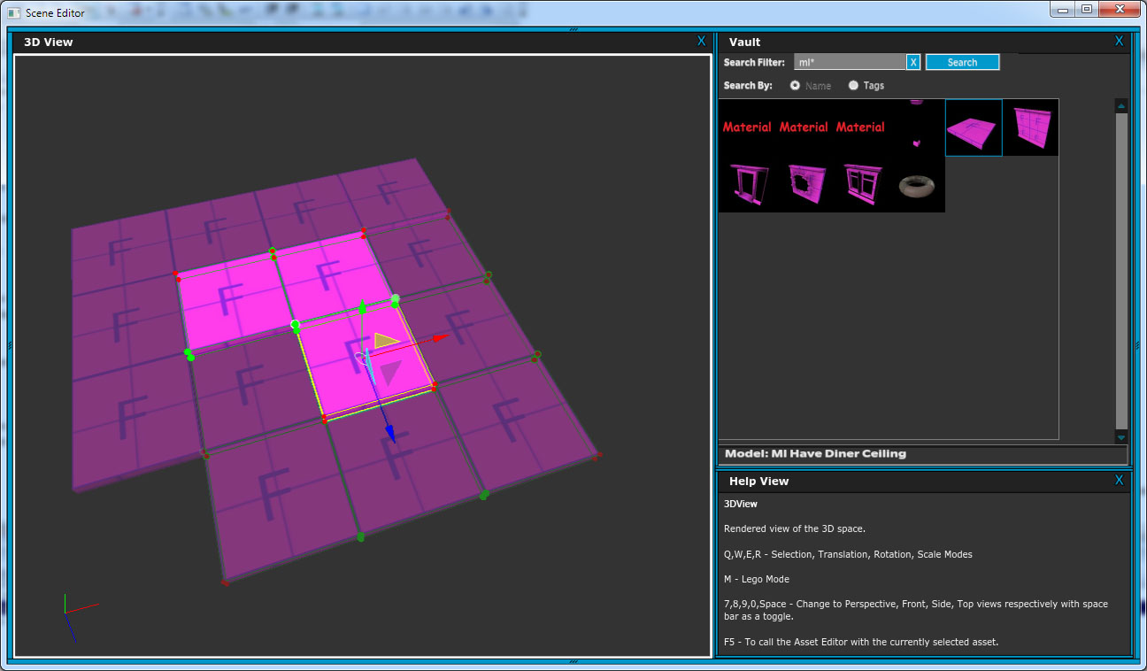

Slide 7
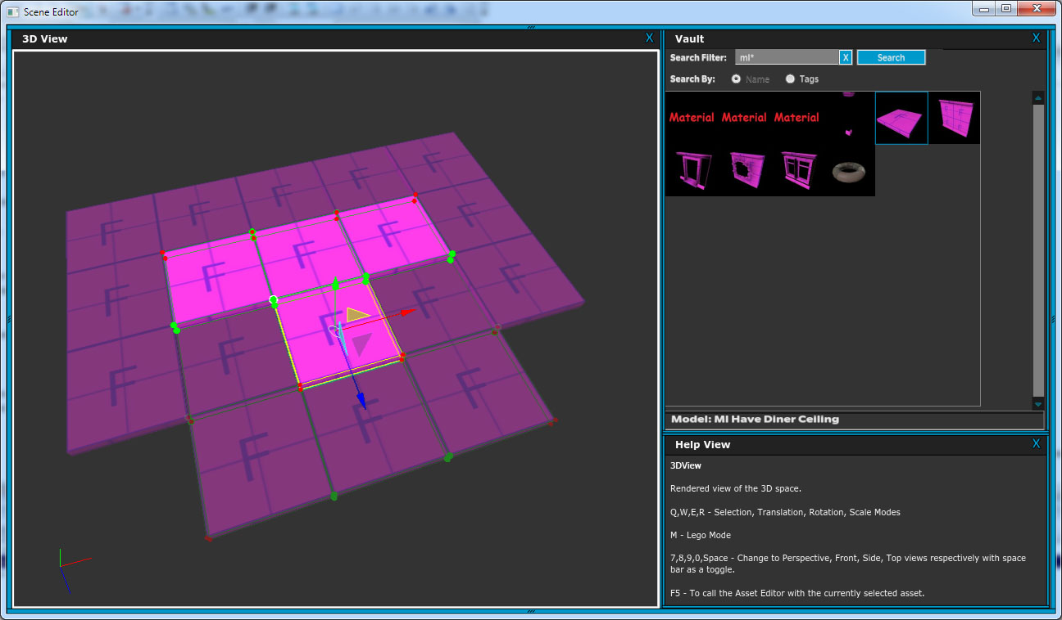

Slide 8
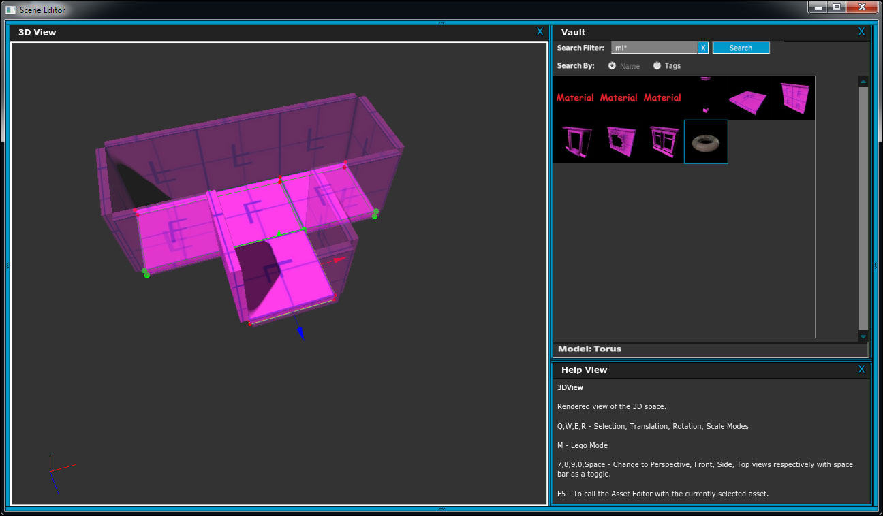
Hit key to tab back to the first set of connections the floor piece was setup with
(floor -> wall)
See all the walls for all the currently selected pieces (i.e. all the new ones we just created.)

Slide 9
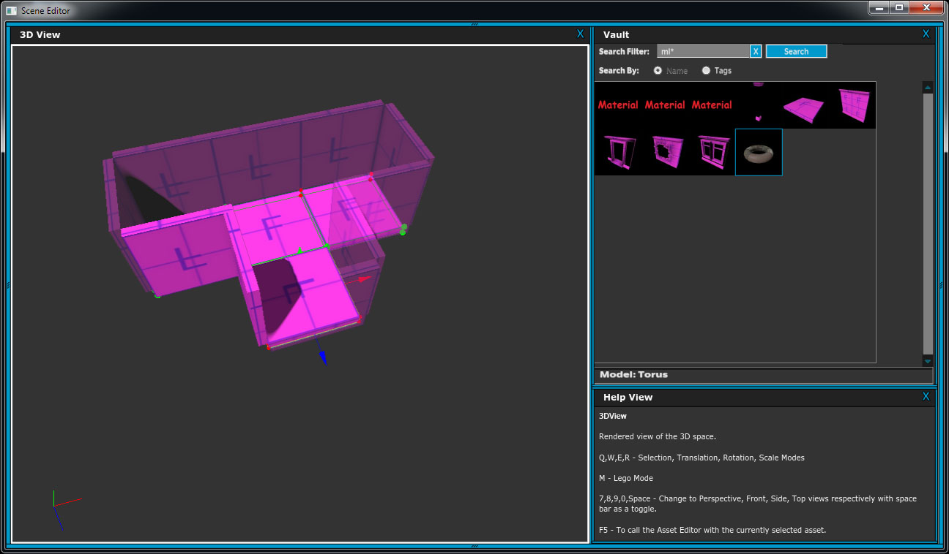
Same process:
Click on ghosted piece to “stamp”
i.e. make that instance.

Slide 10
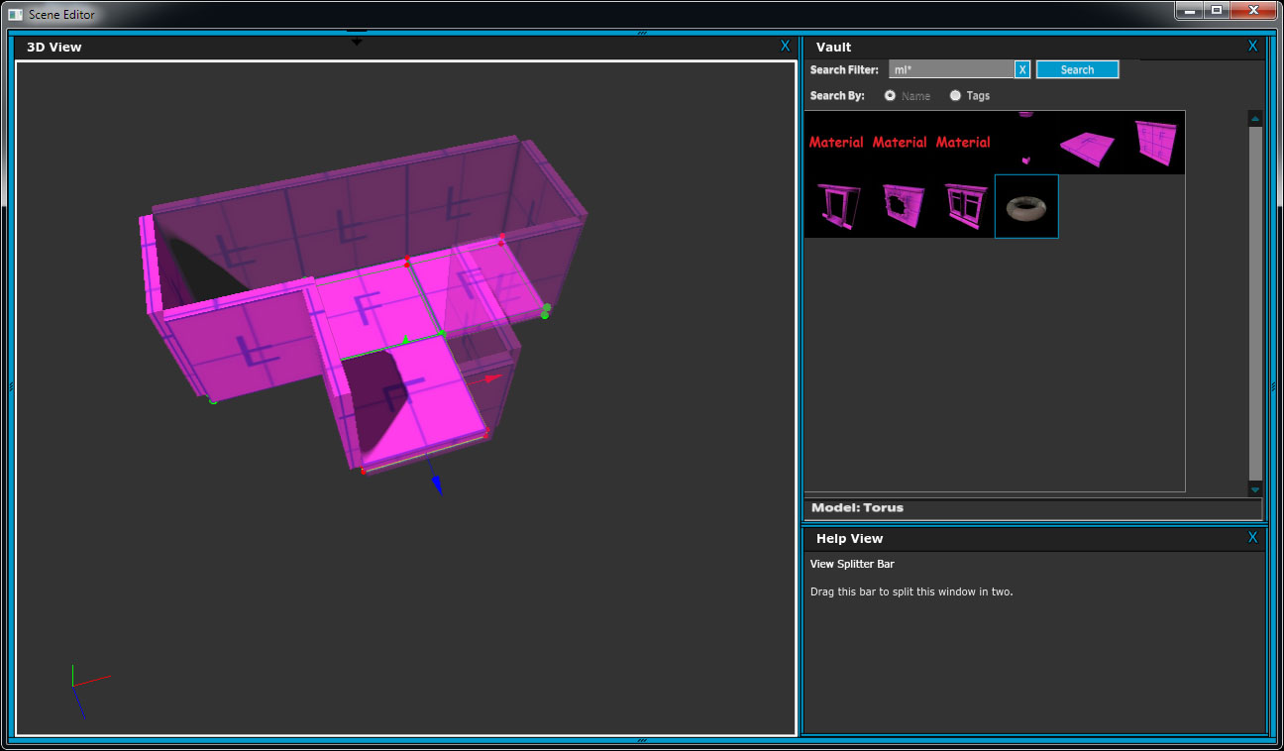

Slide 11
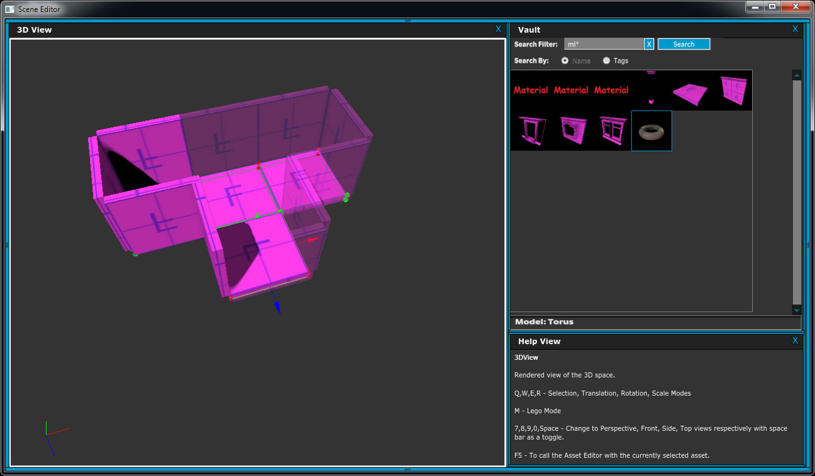

Slide 12
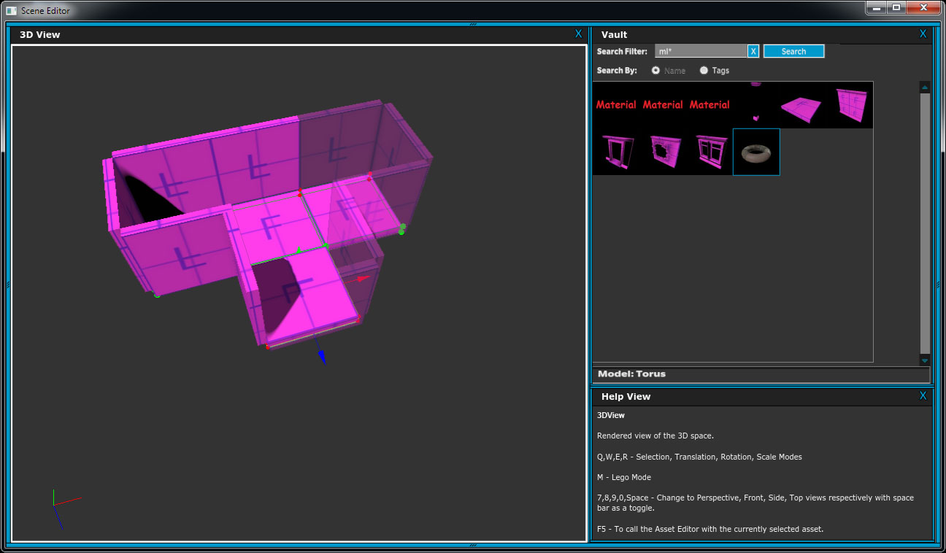

Slide 13
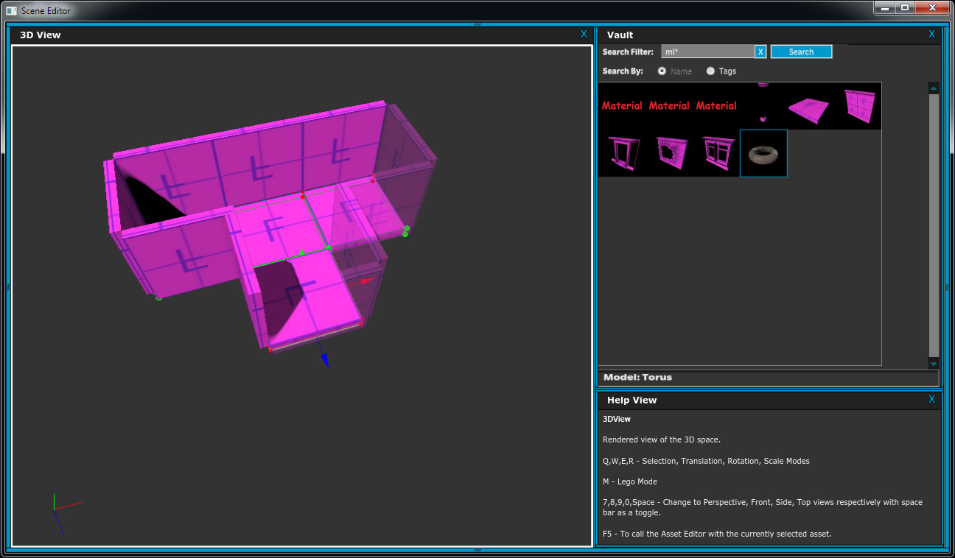

Slide 14
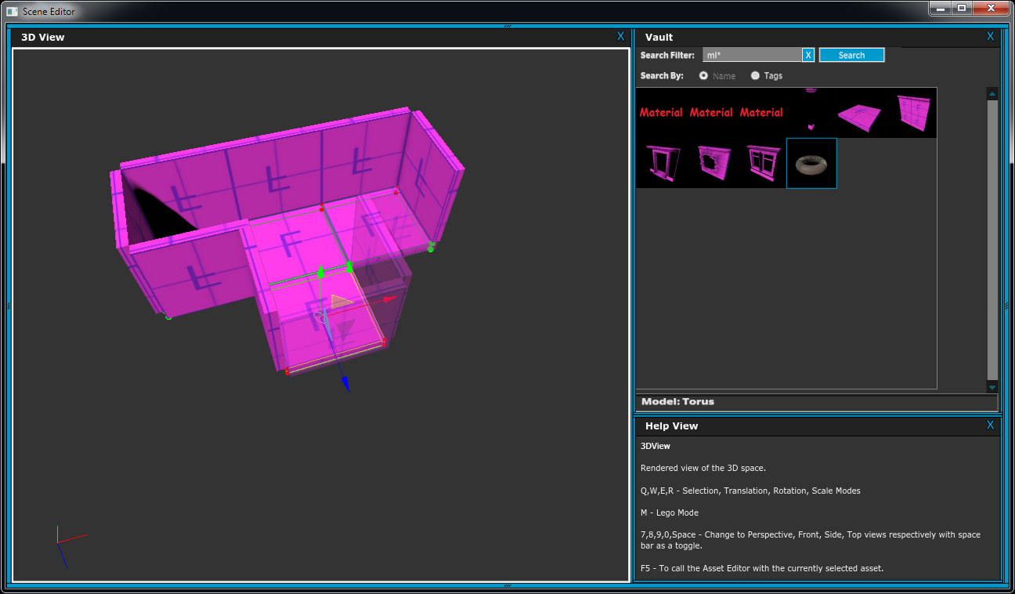

Slide 15


Slide 16
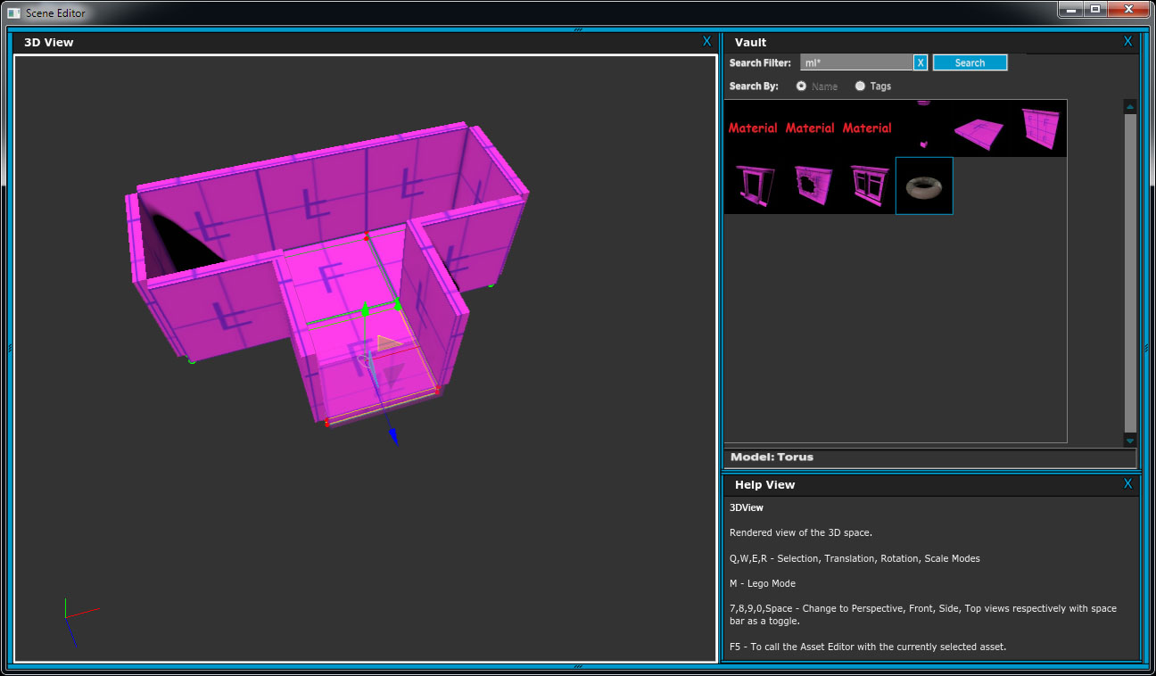

Slide 17
